Slide 1
Nucleotide sequence database: DNA and RNA
23/05/2024
Phuc-Loi Luu, PhD
Luu.p.loi@googlemail.com

Slide 2
Content
Nucleotide [https://www.ncbi.nlm.nih.gov/nucleotide/]
Gene [https://www.ncbi.nlm.nih.gov/gene]

Slide 3
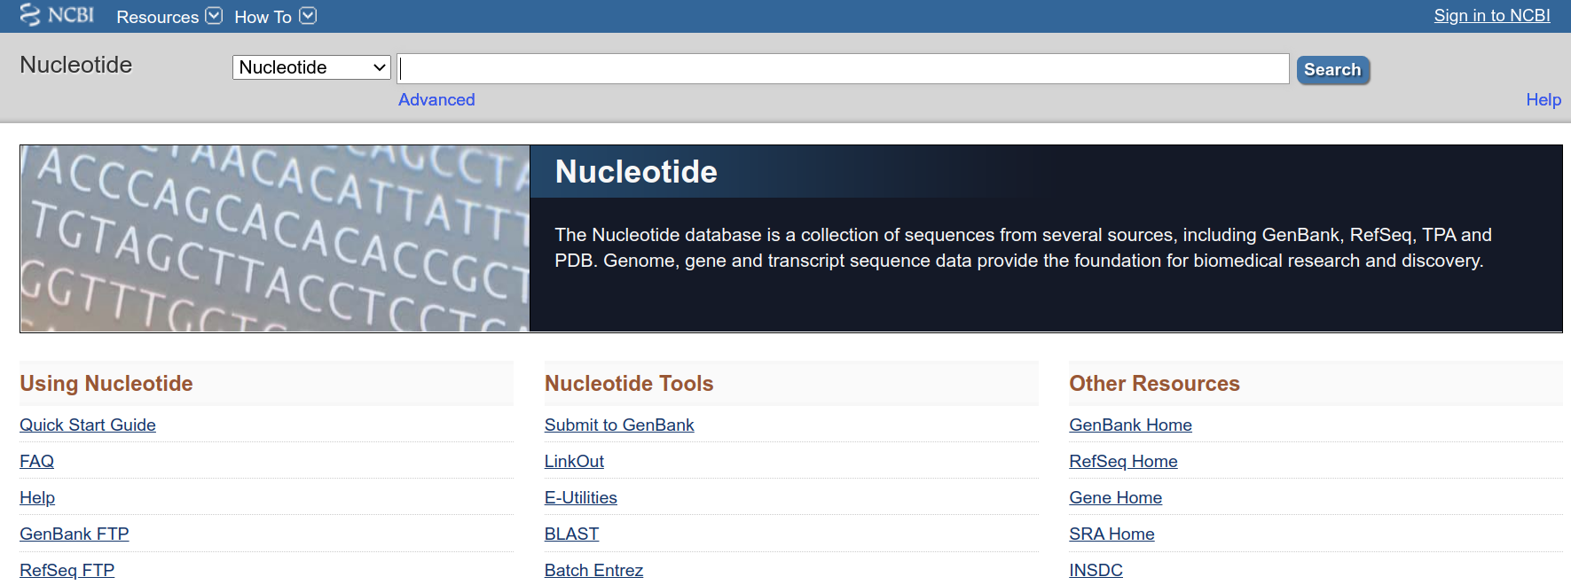
https://www.ncbi.nlm.nih.gov/nucleotide/
Where possible, the sequences are annotated so that you can find the strings of sequences that may be functional.

Slide 4
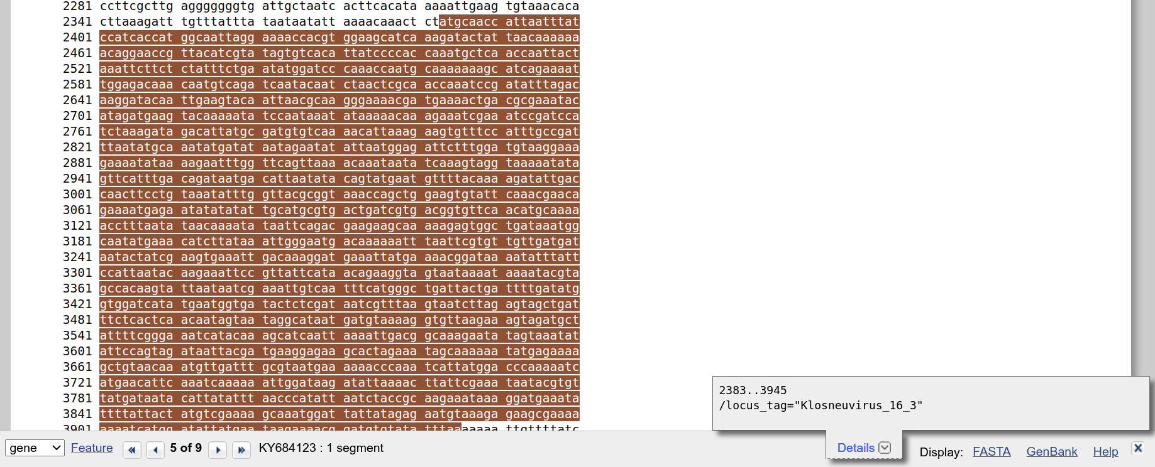
https://www.ncbi.nlm.nih.gov/nucleotide/

Slide 5
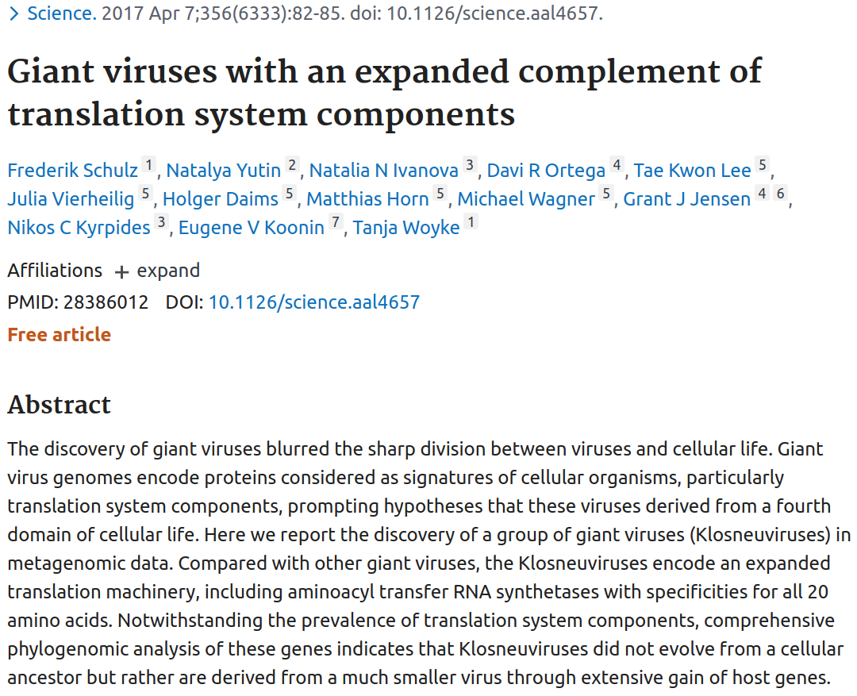
Example 1: Giant Viruses
You might have read in the news or heard on the radio or TV about the new giant viruses that have been discovered.
https://guides.nnlm.gov/tutorial/exploring-ncbi-nucleotide/single-page

Slide 6
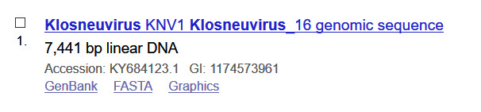
Example 1: Giant Viruses
1) Now try searching the NCBI Nucleotide database for klosneuvirus.
2) Results appear in the middle of the page. Search filters and other discovery tools appear on either side of results.
3) Each result in the database represents a record for one sequence or string of nucleic acids. The strings may overlap.
4) Click on the record for accession number KY684123.1 and view the full record.
5) Record for accession number KY684123.1
[Note: Sidebar images like the above can be expanded by clicking on them.]

Slide 7
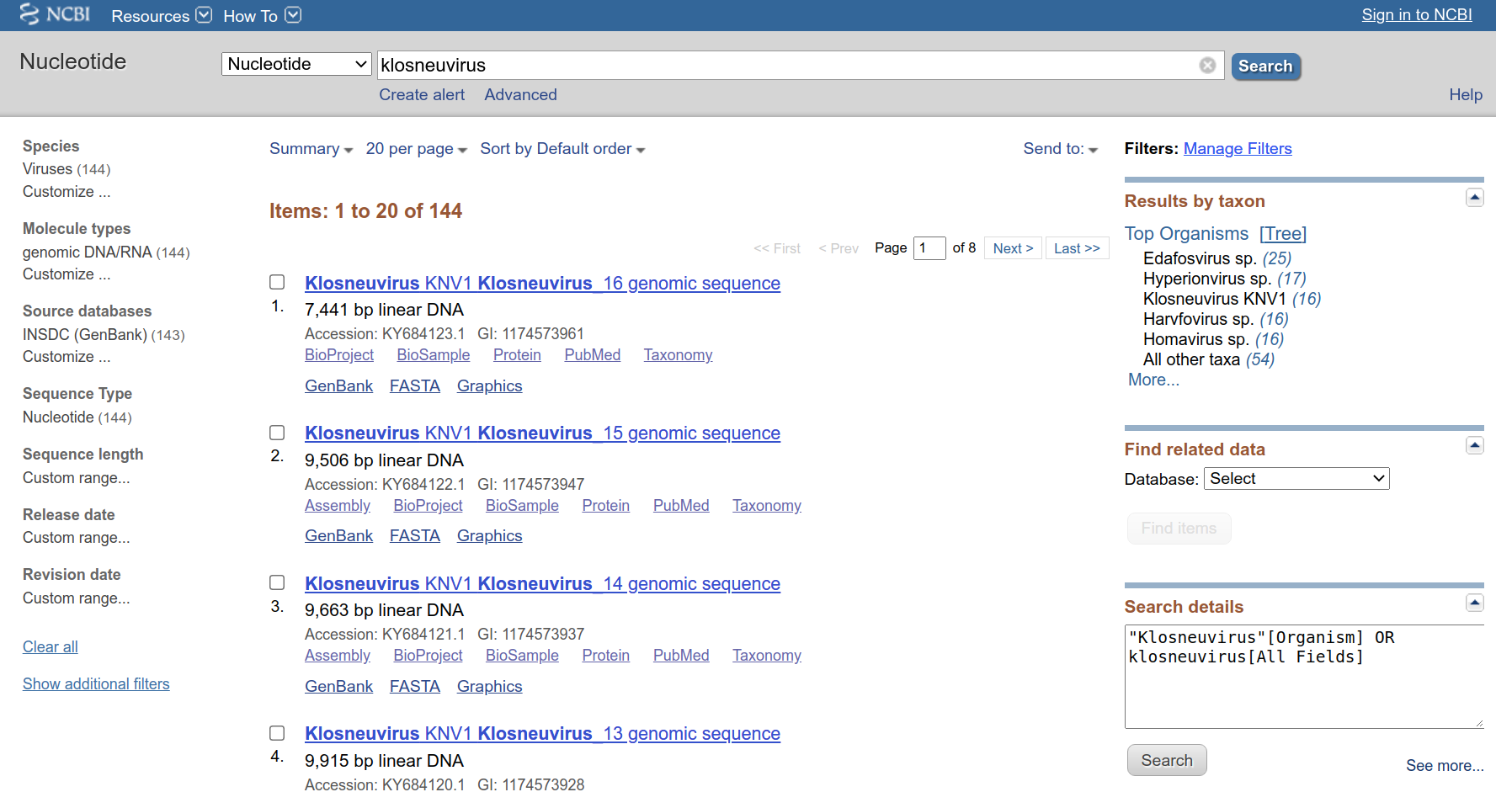
Example 1: Giant Viruses

Slide 8
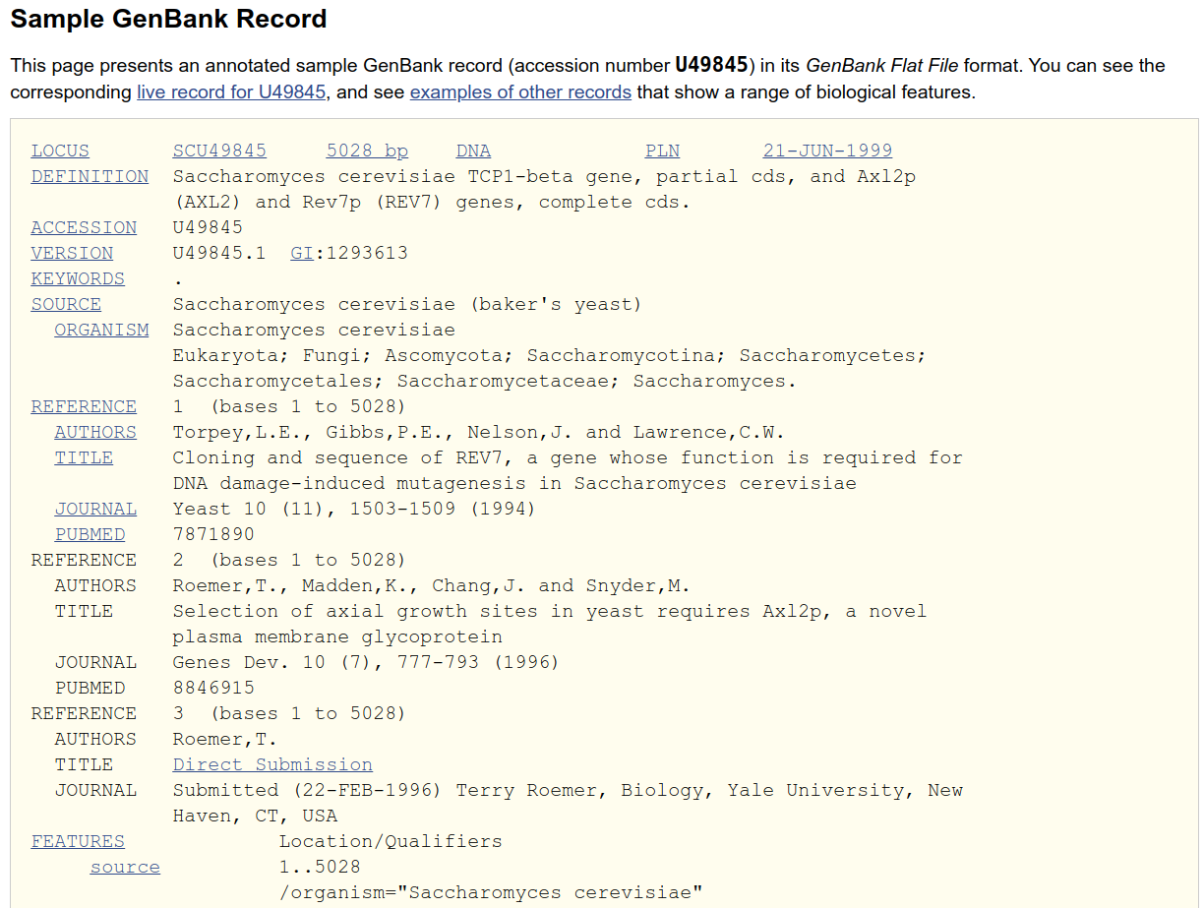
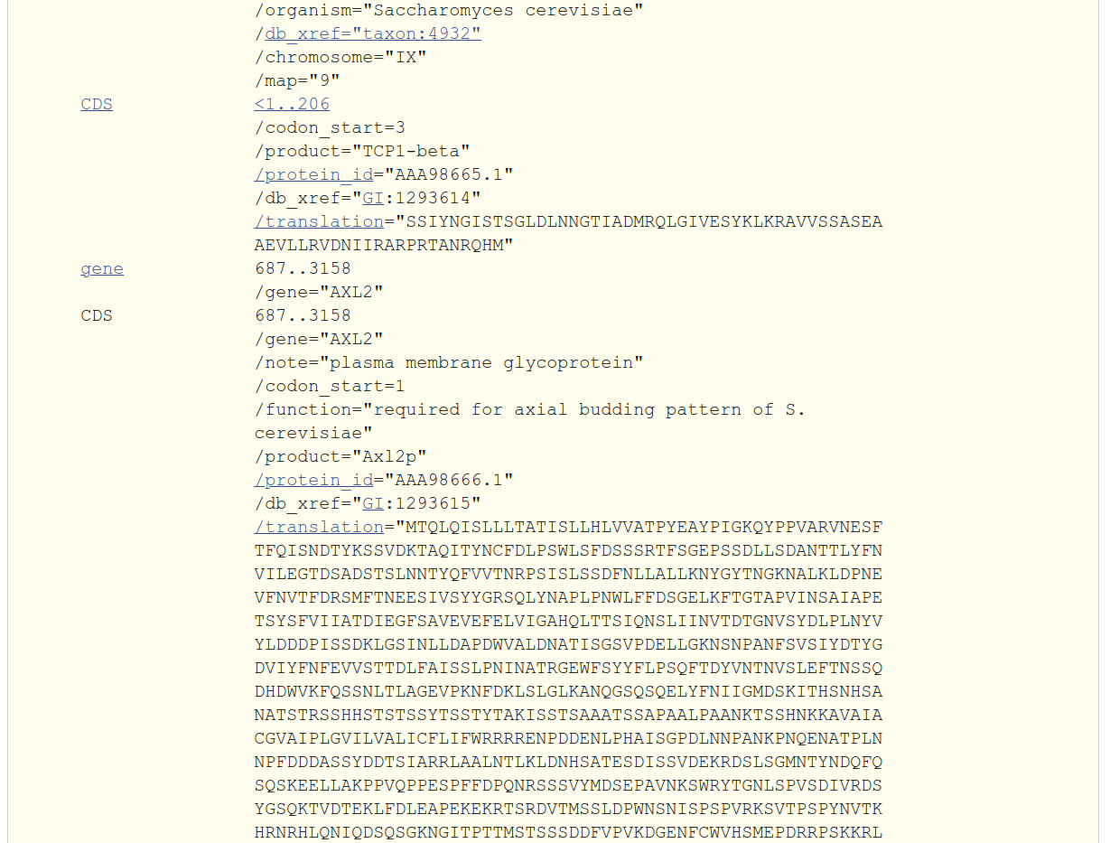
https://www.ncbi.nlm.nih.gov/genbank/samplerecord/

Slide 9
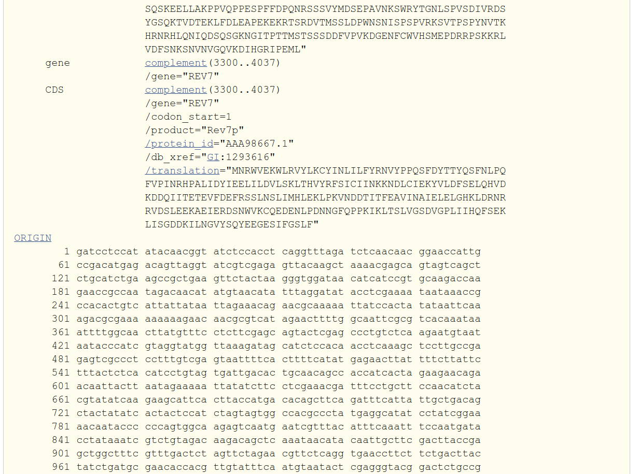
https://www.ncbi.nlm.nih.gov/genbank/samplerecord/

Slide 10
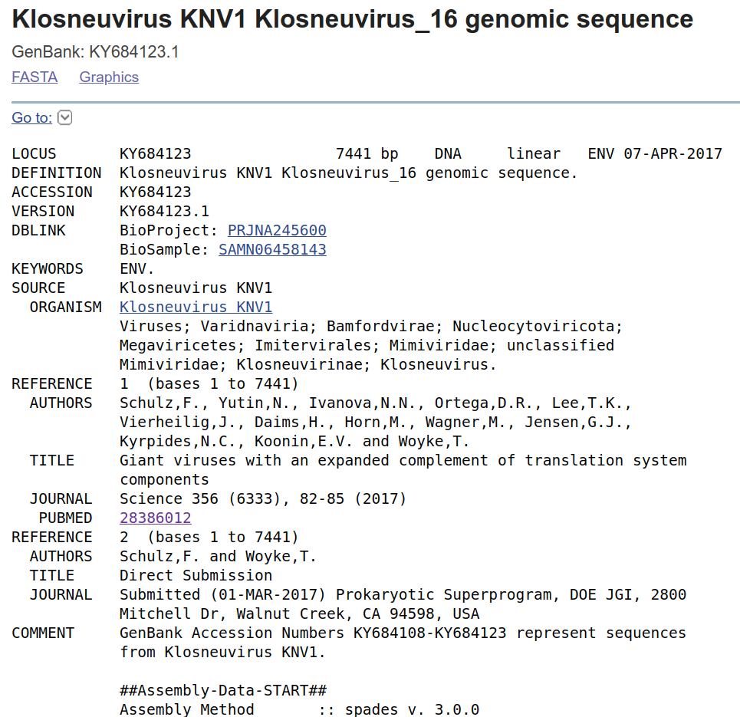
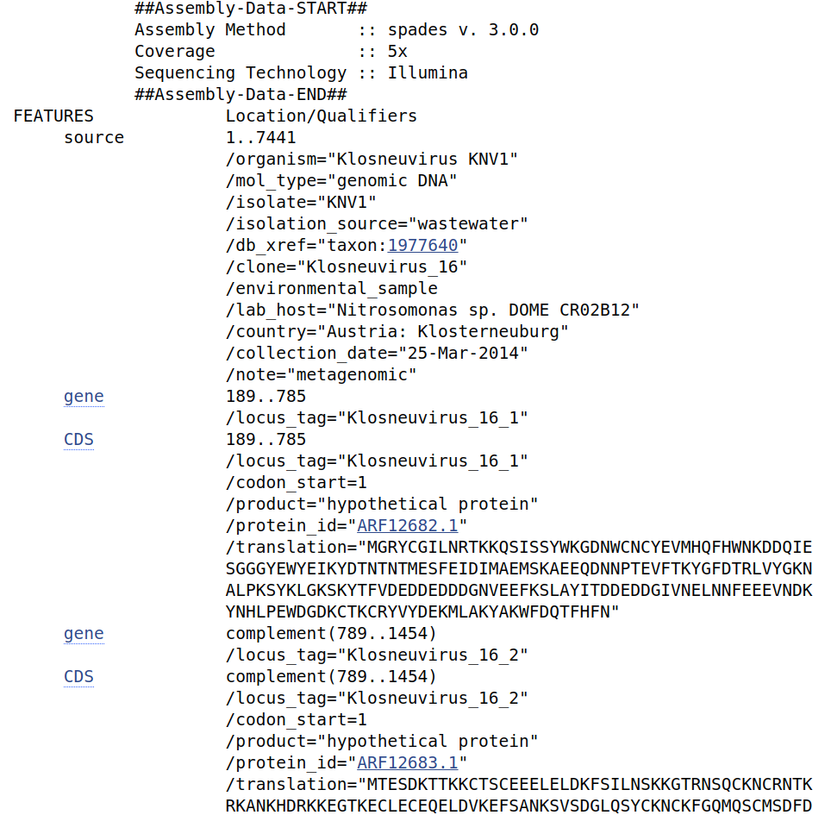
GenBank format
https://www.ncbi.nlm.nih.gov/nuccore/KY684123.1

Slide 11
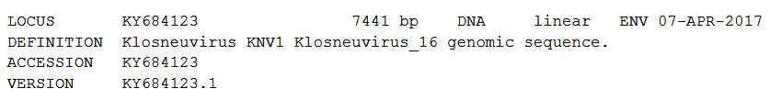
Example 1: Giant Viruses
Look at the record for Klosneuvirus 16 and answer the following questions
What is the sequence length or number of base pairs?
7441
5028
https://www.ncbi.nlm.nih.gov/nuccore/KY684123.1

Slide 12
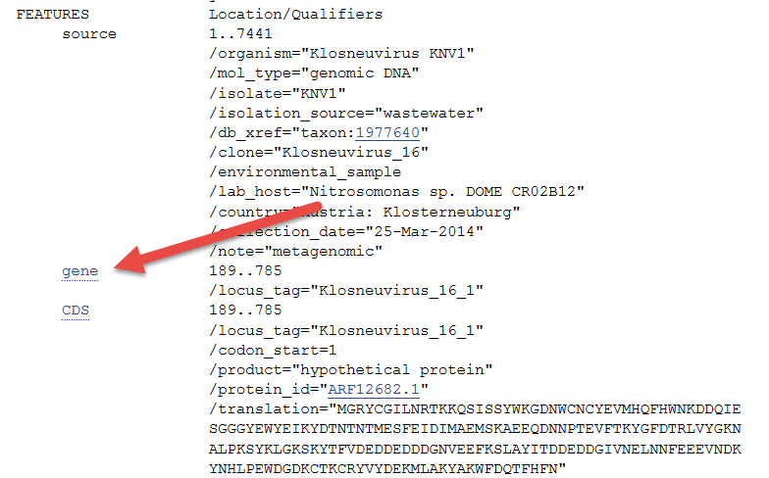
Example 1: Giant Viruses
Scroll down the feature table and click on the first link for "gene"

Slide 13
Example 1: Giant Viruses
This link "jumps" you to the raw sequence data at the bottom of the record, highlighting the part of the sequence identified as a gene. New navigation features appear at the bottom of your screen, allowing you to jump from feature to feature.
How many genes are annotated (‘defined’) on this accession number?
5
47
9

Slide 14
Example 1: Giant Viruses
What are the first ten nucleotides in the HNH endonuclease gene?
ATGCAACCAT
MQLPIYPSPW
GCGTAATGAA
Hint: Look through the feature table to find a part of the sequence with a product labeled, "HNH endonuclease." Follow the link in the feature table to the sequence at the bottom of the record to see the first ten nucleotides.

Slide 15
Example 1: Giant Viruses

Slide 16
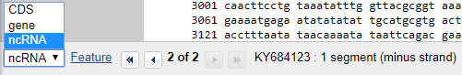
Example 1: Giant Viruses
Are any RNA molecules annotated (‘defined’) on this record (accession number KY684123)?
Yes
No
Hint: check the drop down menu at the bottom of the screen
What is ncRNA?
"ncRNA" stands for "non-coding RNA". It's a sequence that may regulate gene expression, but doesn't code for a protein.

Slide 17
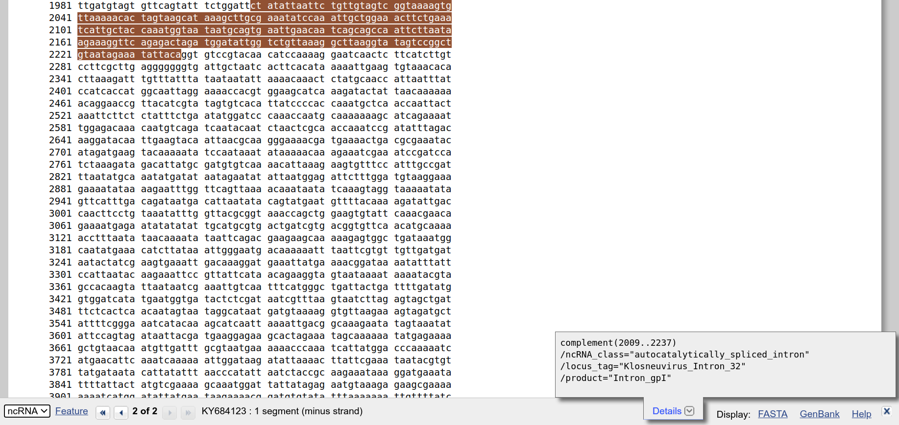
Example 1: Giant Viruses

Slide 18
Example 2: Mitochodrial Transporter SLC25A3
Start a new search at the top of the screen with gene SLC25A3.
What does this gene do?
The protein encoded by this gene catalyzes the transport of phosphate into the mitochondrial matrix, either by proton cotransport or in exchange for hydroxyl ions.
Use your search results from Nucleotide to answer the following 3 questions about SLC25A3:
Approximately how many sequences exist in the NCBI Nucleotide database for the mitochondrial transporter SLC25A3?
30
1800
8000

Slide 19
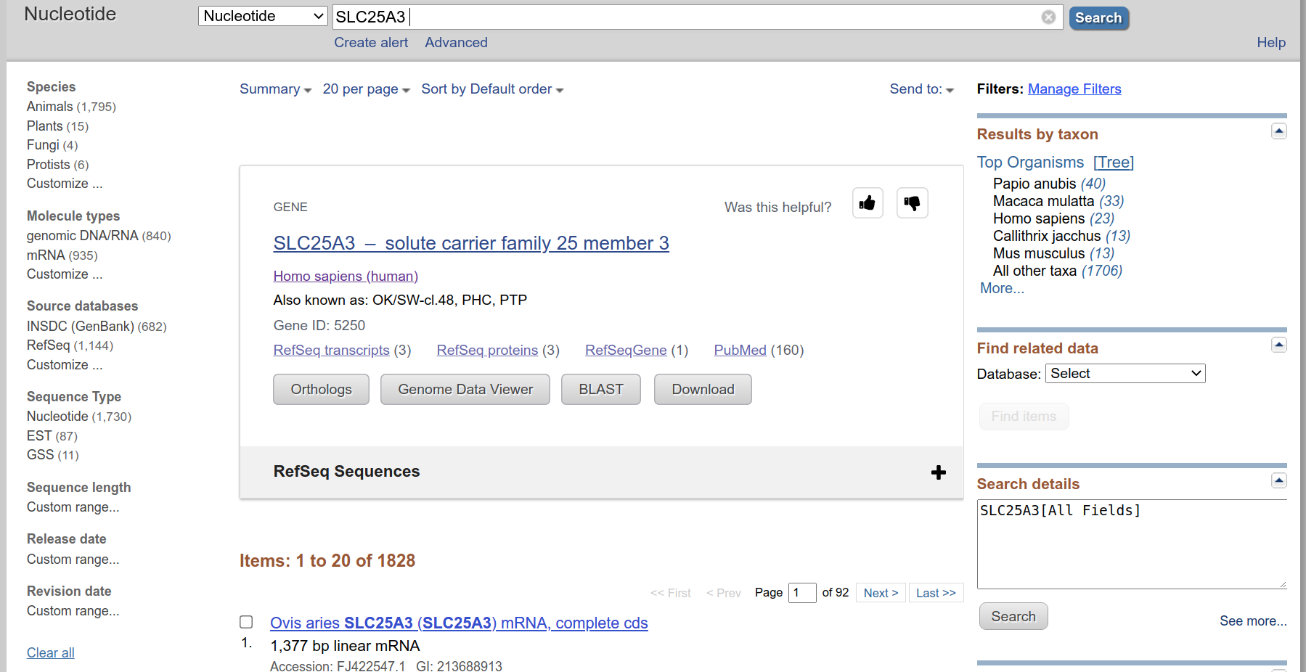
Example 2: Mitochodrial Transporter SLC25A3

Slide 20
Example 2: Mitochodrial Transporter SLC25A3
Approximately how many sequence records in your results are from the INSDC?
6
60
700
HINT: Find your filter options on the left of your screen.
What is INSDC?
The International Nucleotide Sequence Database Collaboration (INSDC) is a long-standing foundational initiative that operates between DDBJ, EMBL-EBI and NCBI. INSDC covers the spectrum of data raw reads, though alignments and assemblies to functional annotation, enriched with contextual information relating to samples and experimental configurations.

Slide 21
Example 2: Mitochodrial Transporter SLC25A3

Slide 22
Example 2: Mitochodrial Transporter SLC25A3
Approximately how many of your search results are RefSeq records?
10
100
1200
What is RefSeq?
RefSeq is short for the NCBI Reference Sequence collection, a comprehensive, integrated, non-redundant, well-annotated set of sequences, including genomic DNA, transcripts, and proteins. RefSeq sequences form a foundation for medical, functional, and diversity studies.

Slide 23
Example 2: Mitochodrial Transporter SLC25A3

Slide 24
Example 2: Mitochodrial Transporter SLC25A3
Now start a new search using the Advanced page
Search for SLC25A3 in the Title field.
How much of a difference is there between the results for this search and your last one?
There are MORE results by searching in the Title field
There are LESS results by searching in the Title field
There is not a significant difference
Hint: Compare the following searches:
SLC25A3
SLC25A3[title]

Slide 25
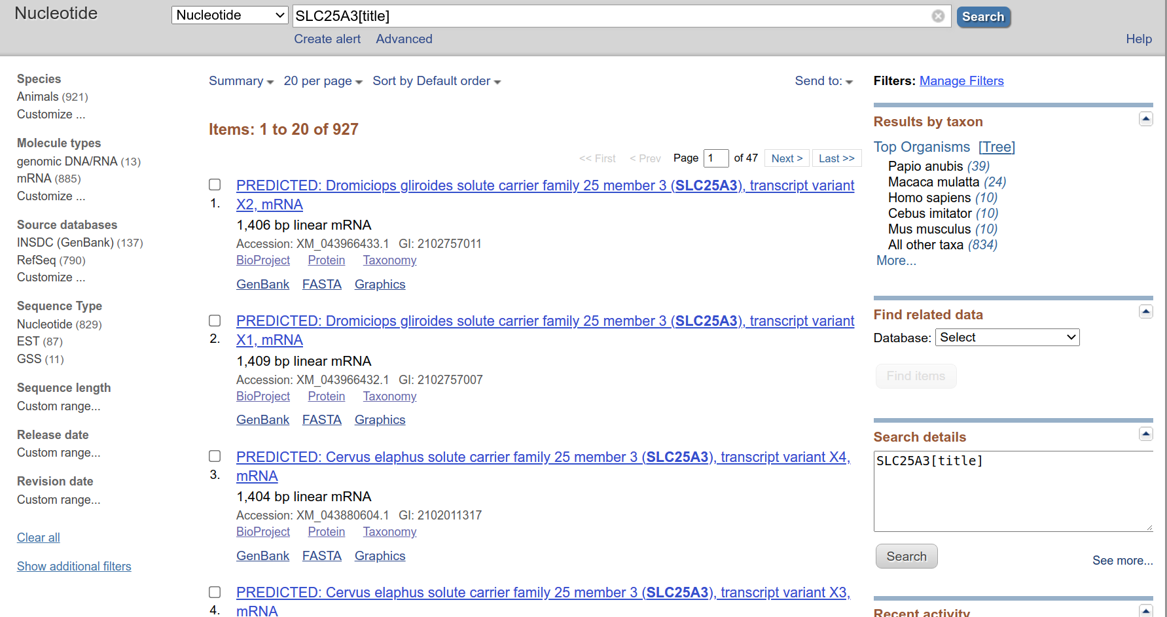
Example 2: Mitochodrial Transporter SLC25A3

Slide 26
Example 2: Mitochodrial Transporter SLC25A3
Return to your search results for your SLC25A3 search (WITHOUT the [title] field restriction).
Are there any SLC25A3 sequences in plants?
Yes
No
Hint: Check the Species filters in the left column of your results.

Slide 27
Example 2: Mitochodrial Transporter SLC25A3

Slide 28
Example 3: Human tyrosine hydroxylase
Start a new search at the top of the screen.
Find human tyrosine hydroxylase gene sequence records.
What does this gene do?
This gene can cause Segawa syndrome and is important in the synthesis of catecholamines (which are important pharmacologic agents).
What is the gene symbol or abbreviation for tyrosine hydroxylase?
The official gene symbol for tyrosine hydroylase is TH.
This is included in most titles of Nucleotide records, record with TH in title
A place to check official gene names is the HGNC, or HUGO Gene Nomenclature Committee. (https://www.genenames.org/)

Slide 29
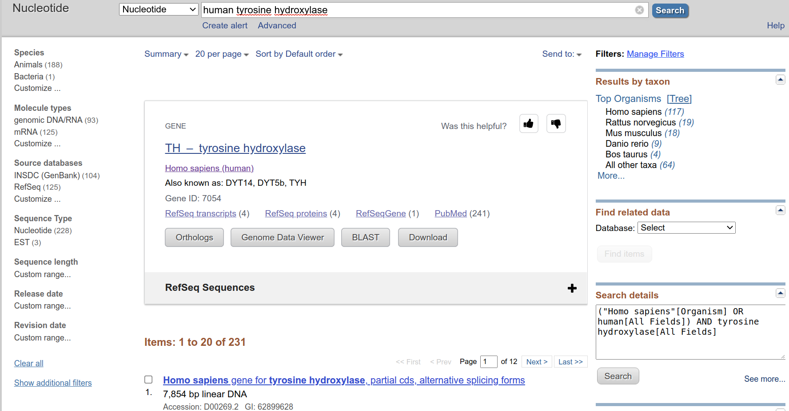
Example 3: Human tyrosine hydroxylase

Slide 30
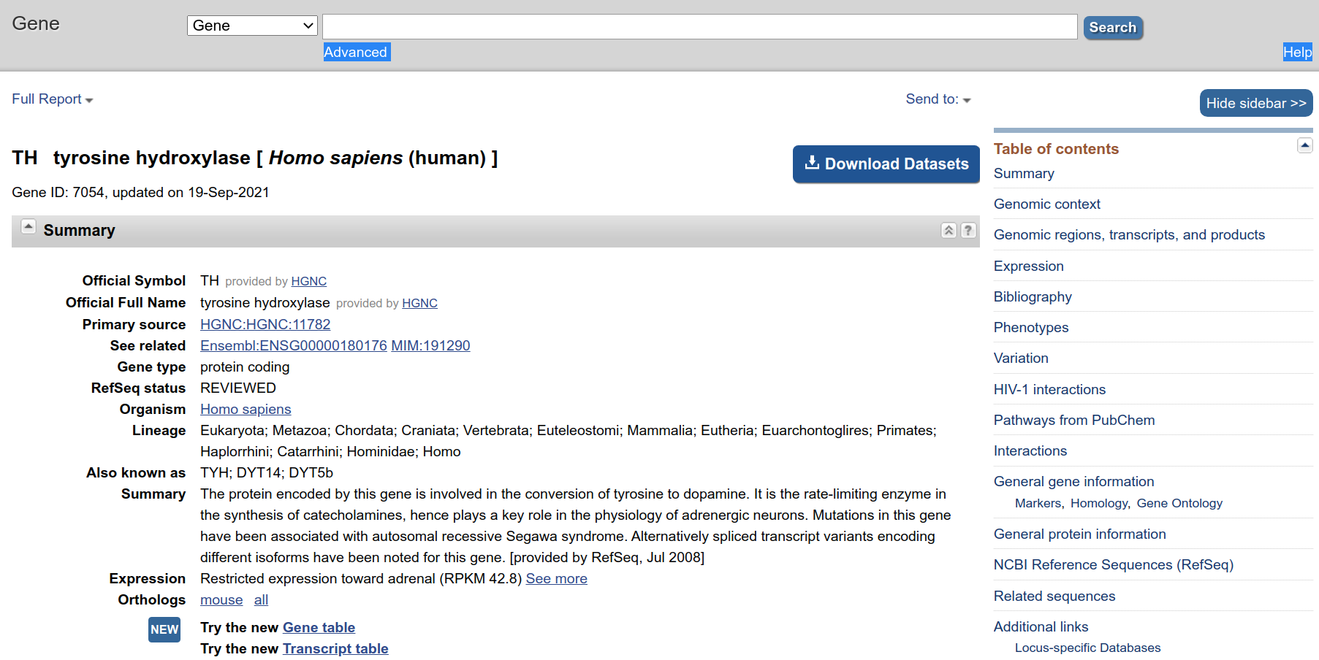
Gene

Slide 31
Gene: https://www.ncbi.nlm.nih.gov/gene/7054

Slide 32
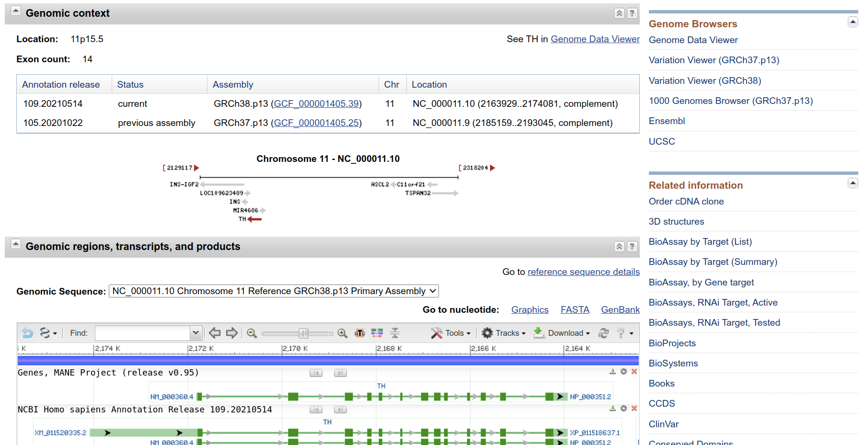
Gene: https://www.ncbi.nlm.nih.gov/gene/7054

Slide 33
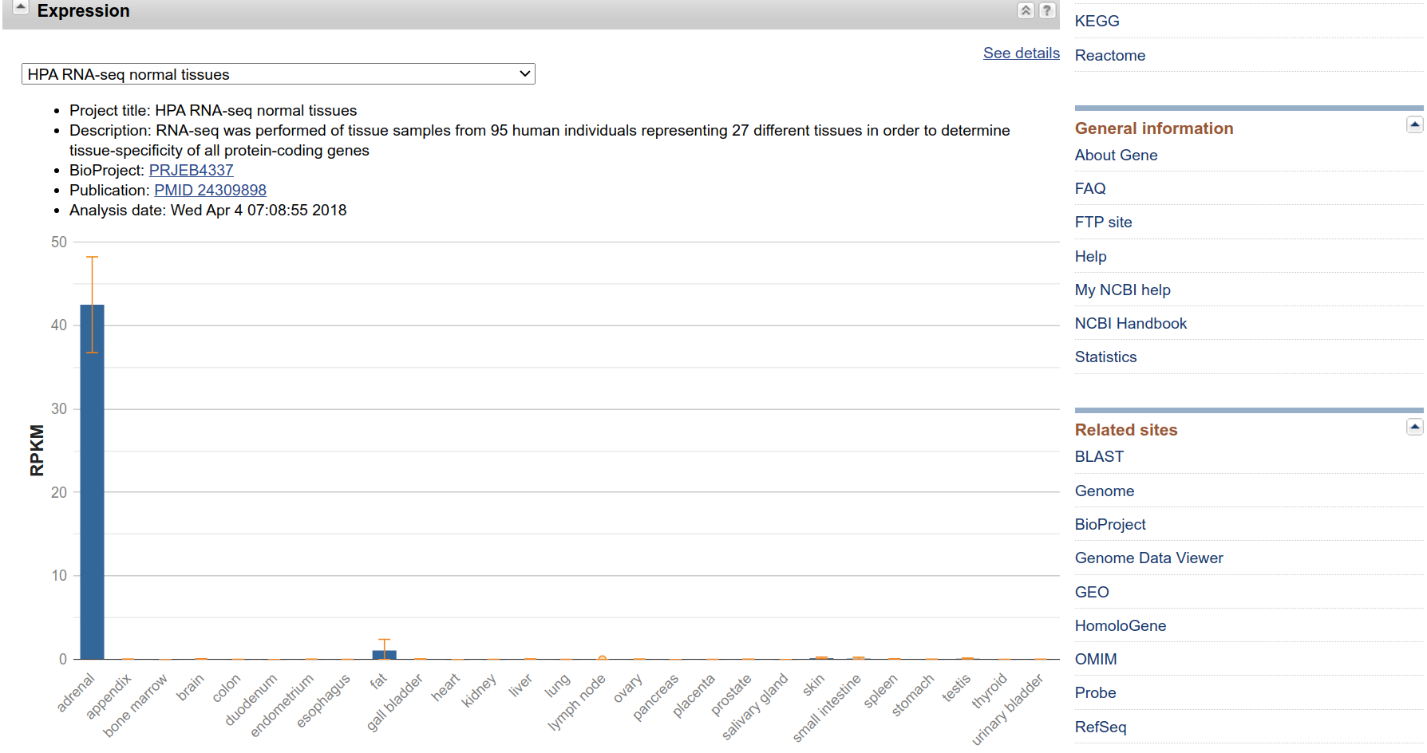
Gene: https://www.ncbi.nlm.nih.gov/gene/7054

Slide 34
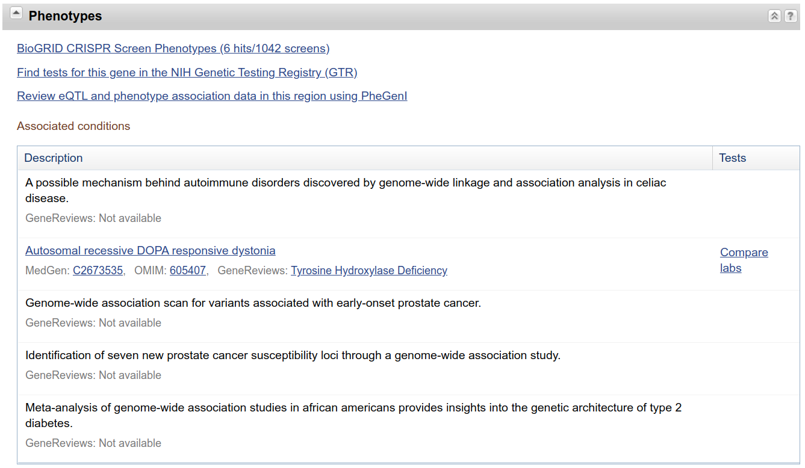
Gene: https://www.ncbi.nlm.nih.gov/gene/7054

Slide 35
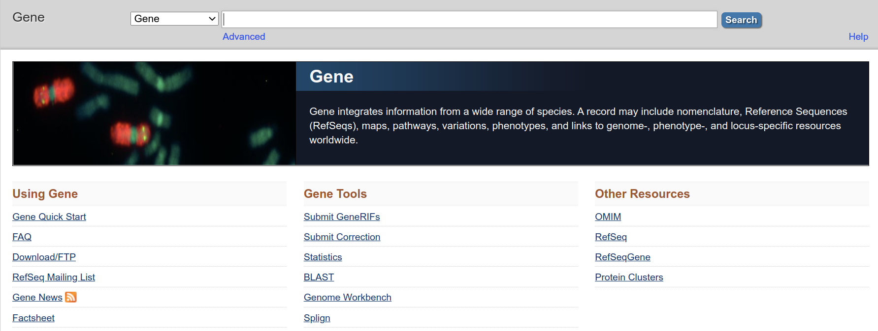
Gene: https://www.ncbi.nlm.nih.gov/gene/

Slide 36
Example 3: Human tyrosine hydroxylase
Look at the following accession records, all of which are in your search results for the tyrosine hydroxylase (TH) gene:
L15440.1
X05290.1
M17589.1
How are these records different from each other? Look at their sizes, their sources, any descriptive notes, and their feature tables.
HINT: These three records are in your search results, but for easier comparison search Nucleotide for: L15440.1 OR X05290.1 OR M17589.1

Slide 37
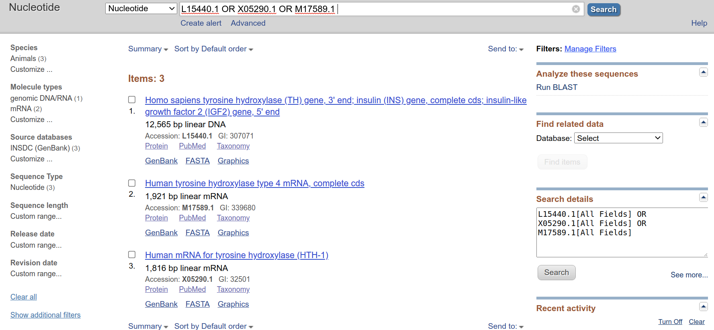
Example 3: Human tyrosine hydroxylase

Slide 38
Example 3: Human tyrosine hydroxylase
Each of the records you looked at included a sequence that codes for the TH gene.
L15440.1 : The record title says it all. This records a human DNA sequence that includes several genes, not just TH. And it only has the 3' end of the TH gene. See the top of the feature table, and you can see that base pairs 1 through 1482 are part of the TH gene.
X05290 : This records an mRNA sequence that encodes a single protein product, identified as “tyrosine hydroxylase (HTH-1)”. Note that it includes only about 1,800 base pairs. In the CDS portion of the feature table, note that the protein product is called HTH-1.
M17589.1 : The feature table on this record includes only one gene and one CDS region. Note that the literature reference says that "alternative RNA splicing produces four kinds of mRNA from a single gene" and the annotation in the feature table says that this one is type 4.
Extra tip: to find records with variation features, use the Advanced Search function,

Slide 39
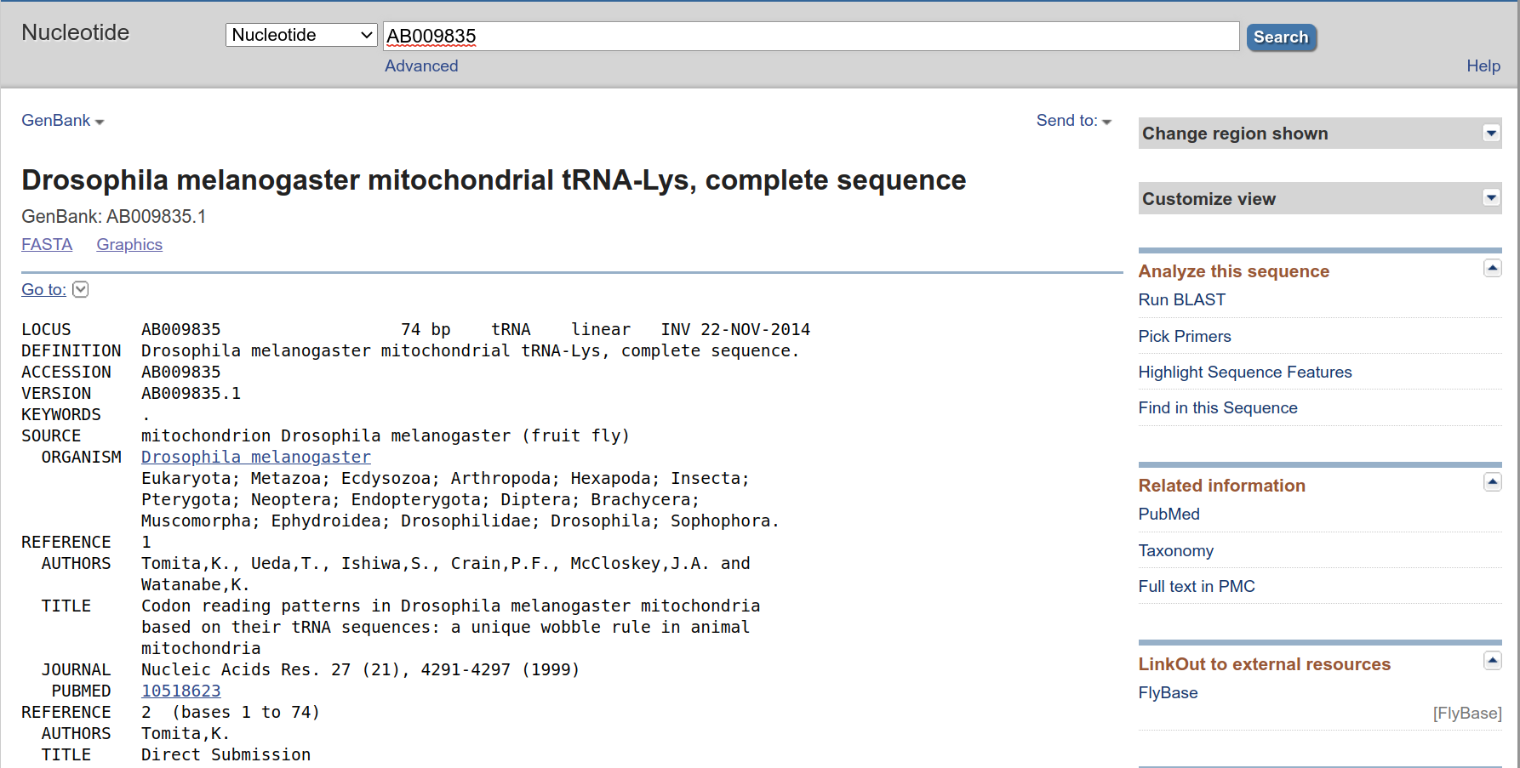
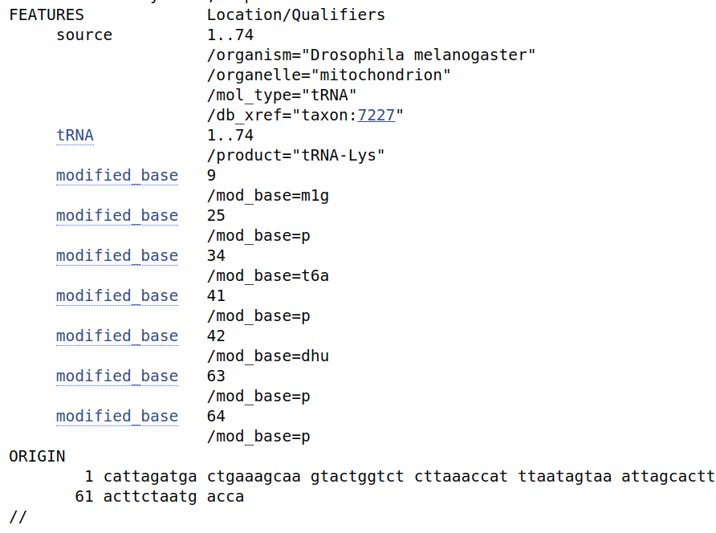
Example 4: tRNA
Search for AB009835. What is this sequence molecular type? Source of this sequence?
https://www.ncbi.nlm.nih.gov/nuccore/AB009835

Slide 40
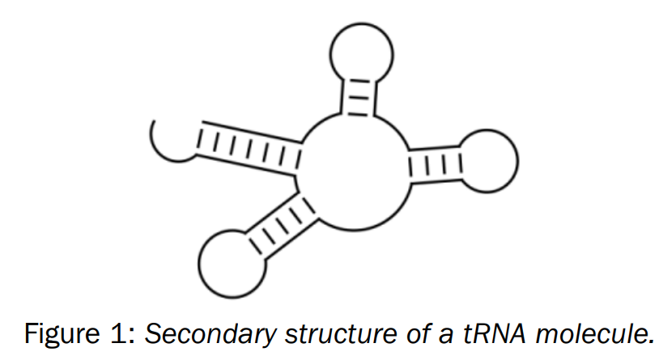
Example 4: tRNA
Predict the folding of AB009835 tRNA

Slide 41
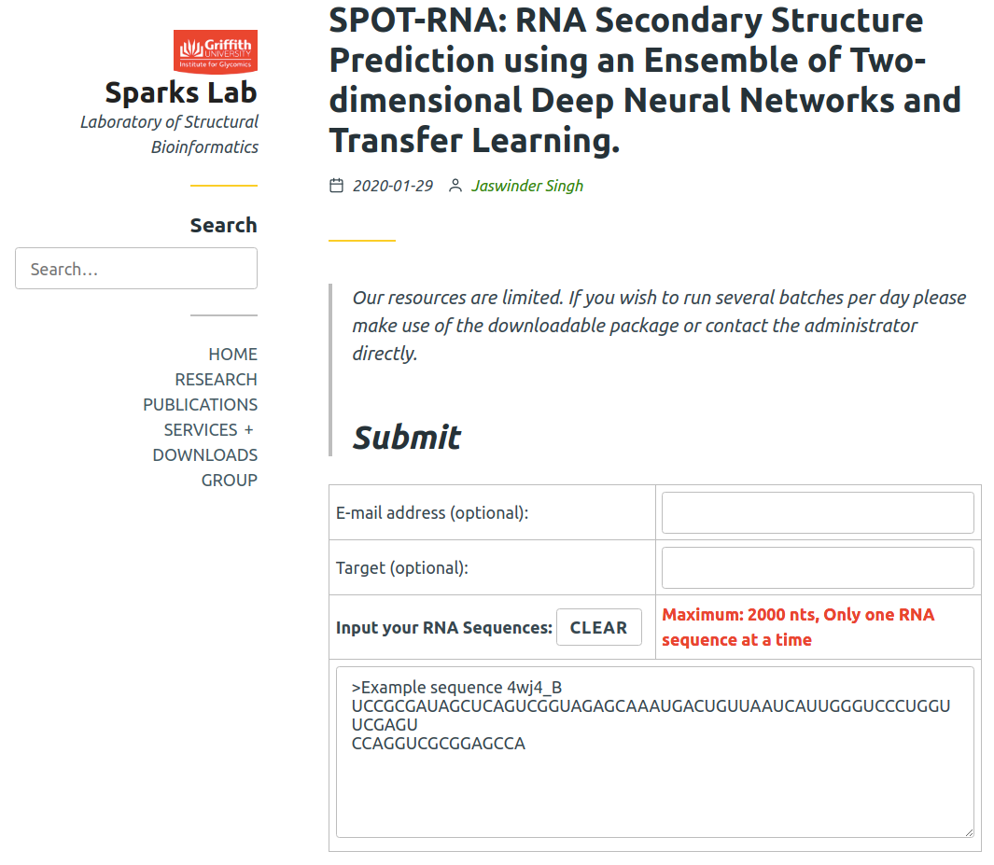
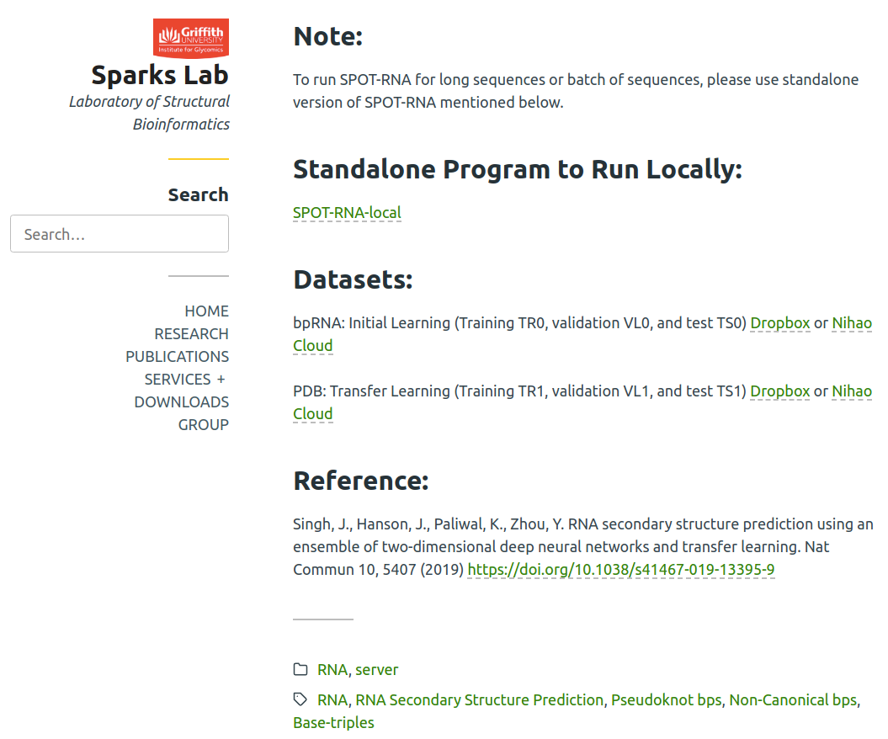
https://sparks-lab.org/server/spot-rna/
https://www.nature.com/articles/s41467-019-13395-9

Slide 42
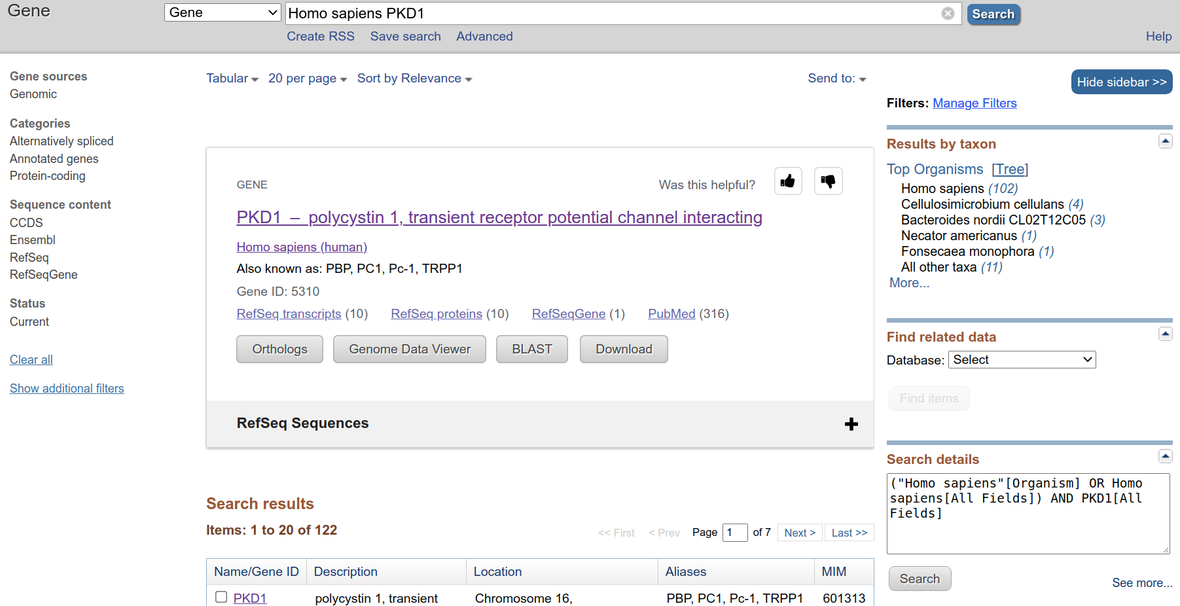
Example 5: Human PKD1
Search with Human PKD1 Gene.

Slide 43
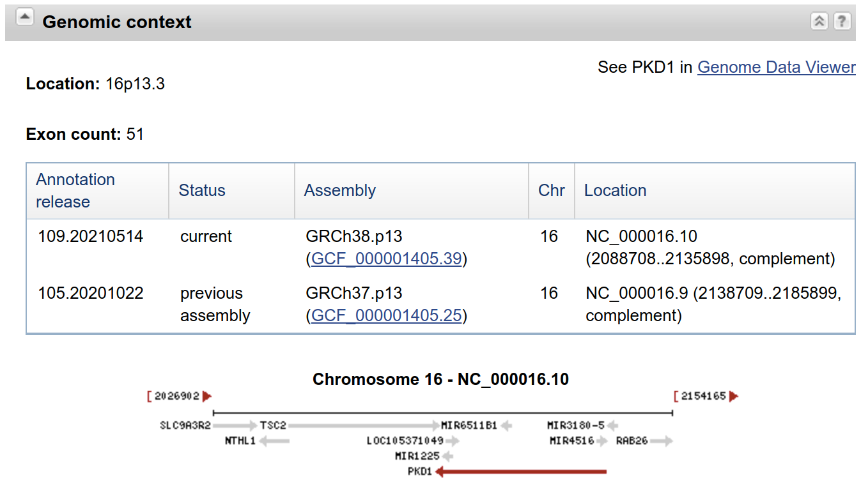
Example 5: Human PKD1
How many exons of Human PKD1?
https://www.ncbi.nlm.nih.gov/gene/5310

Slide 44
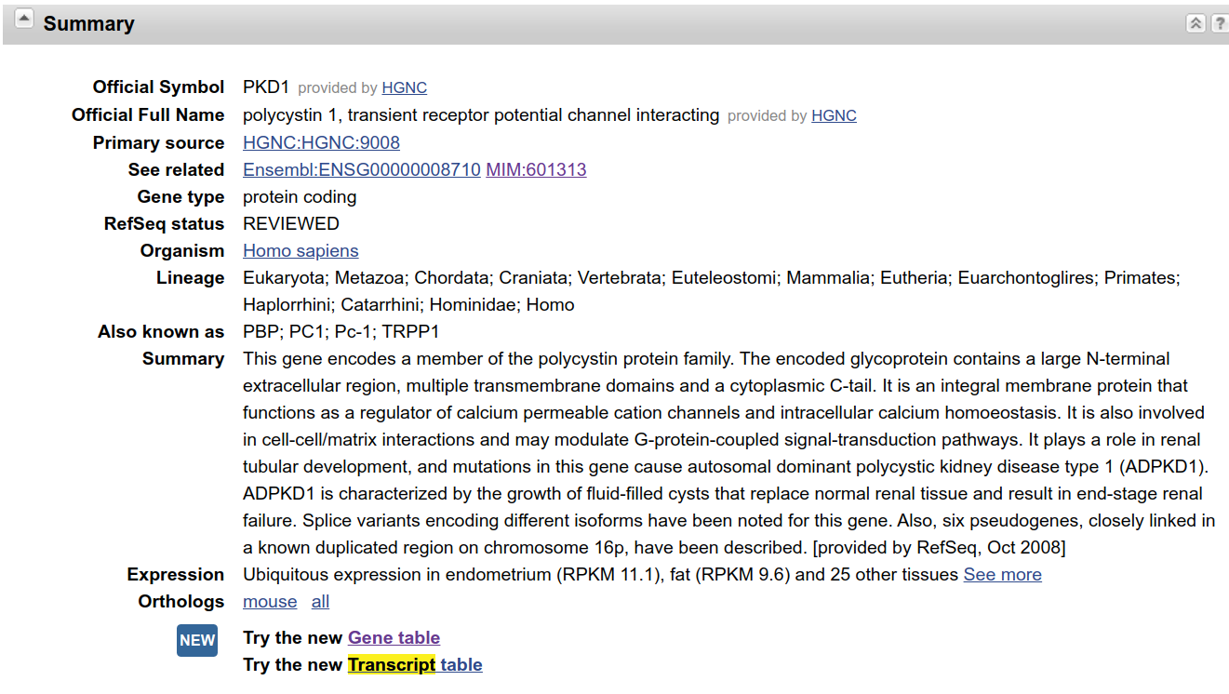
Example 5: Human PKD1
How many transcripts of Human PKD1?
https://www.ncbi.nlm.nih.gov/gene/5310

Slide 45
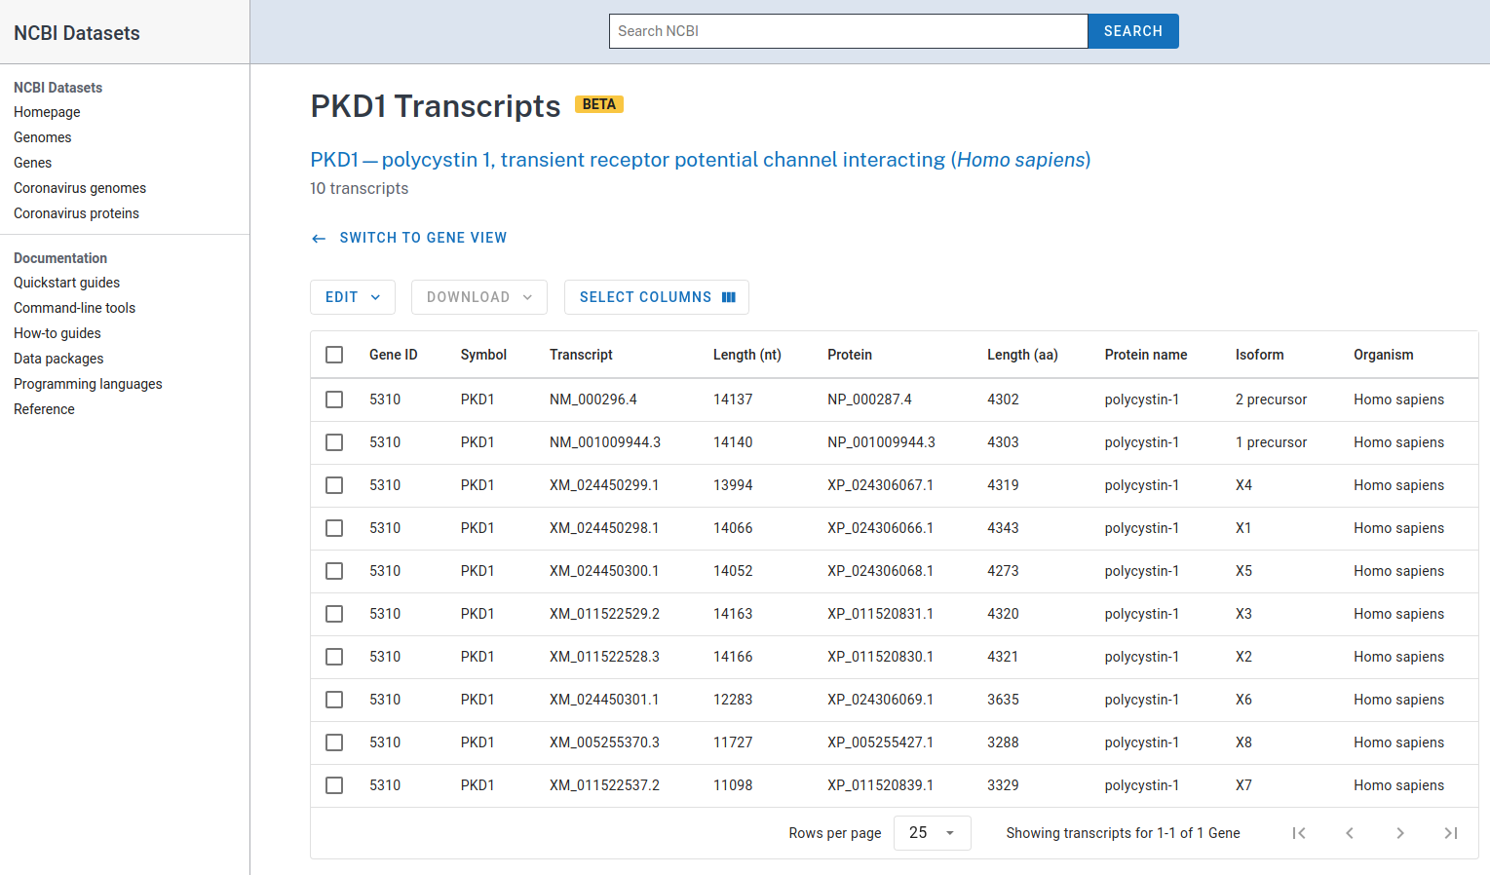
Example 5: Human PKD1
How many transcripts of Human PKD1?
https://www.ncbi.nlm.nih.gov/gene/5310

Slide 46
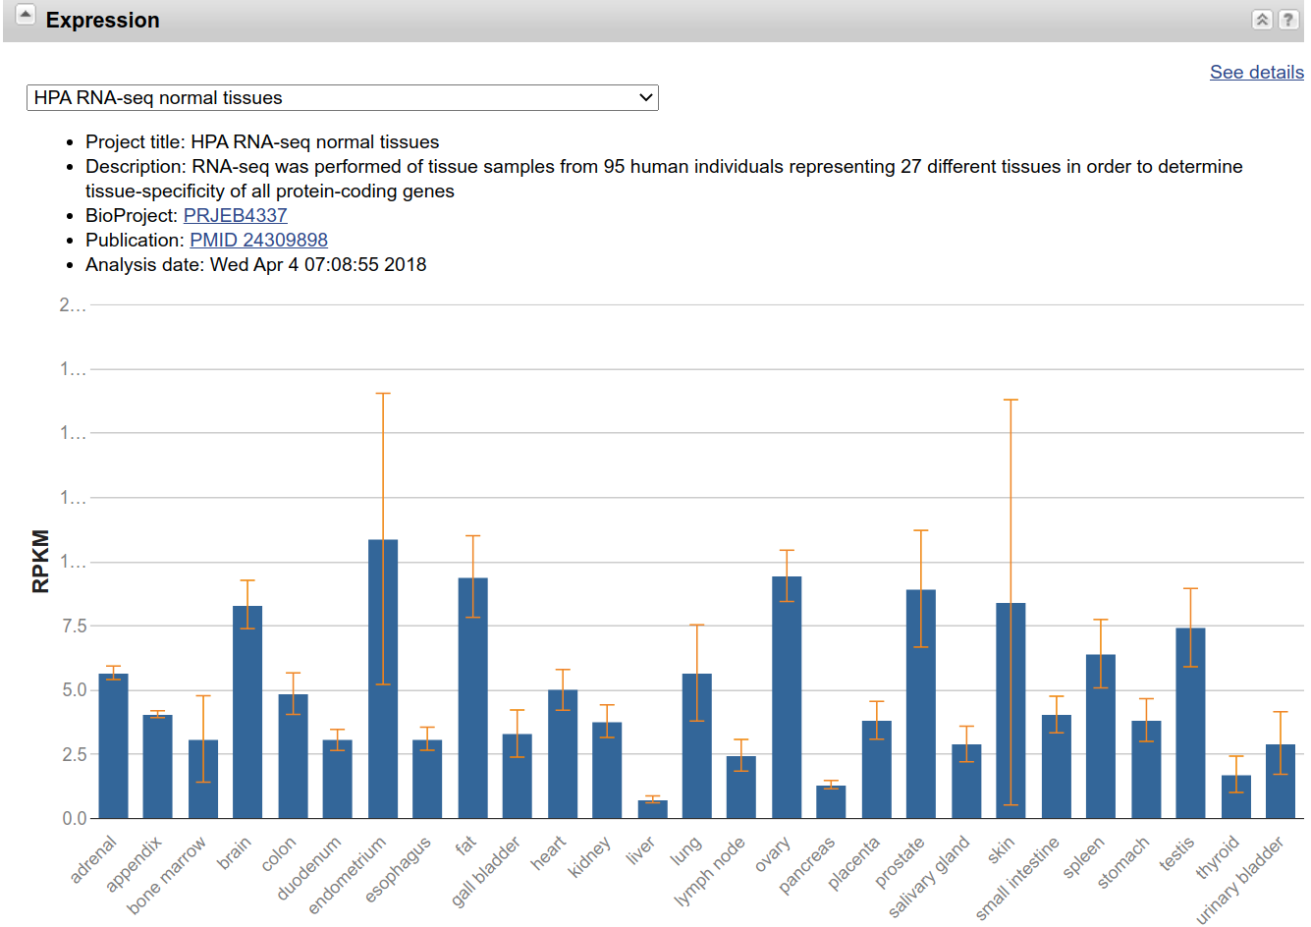
Example 5: Human PKD1
Is Human PKD1 expressed in all the tissues?
https://www.ncbi.nlm.nih.gov/gene/5310

Slide 47
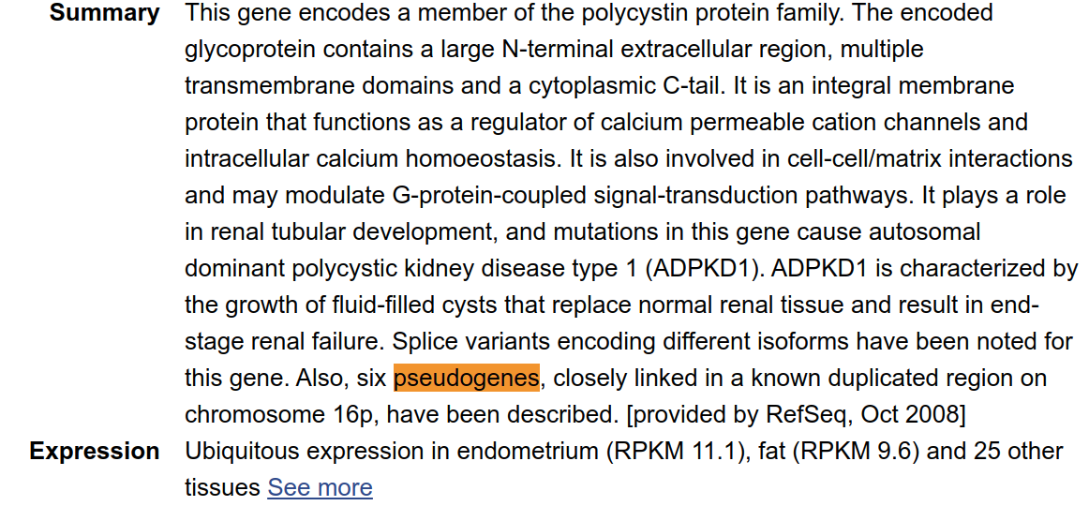
Example 5: Human PKD1
How many pseudogenes of Human PKD1?
https://www.ncbi.nlm.nih.gov/gene/5310

Slide 48
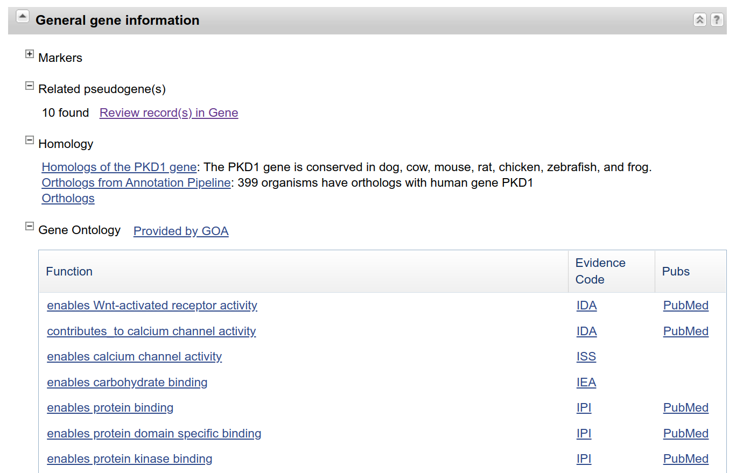
Example 5: Human PKD1
How many pseudogenes of Human PKD1?
https://www.ncbi.nlm.nih.gov/gene/5310

Slide 49
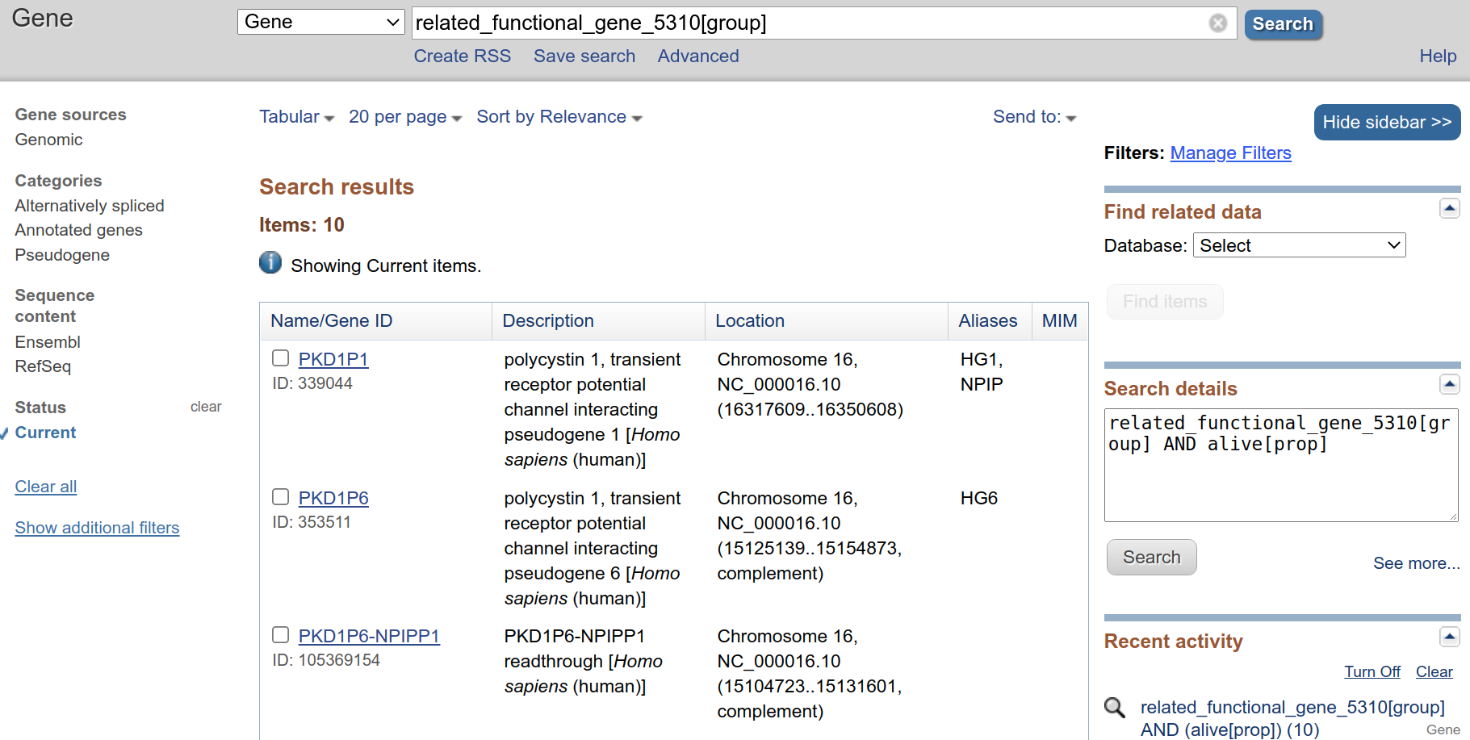
Example 5: Human PKD1
How many pseudogenes of Human PKD1?
https://www.ncbi.nlm.nih.gov/gene/?Term=related_functional_gene_5310%5Bgroup%5D

Slide 50
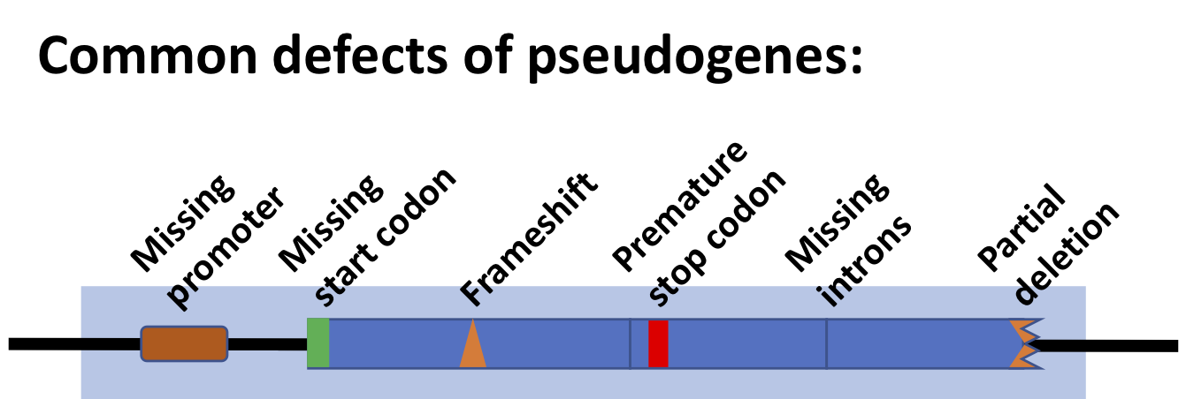
Example 5: Human PKD1
What is Pseudogenes?
Pseudogenes are nonfunctional segments of DNA that resemble functional genes.
Most arise as superfluous copies of functional genes, either directly by DNA duplication or indirectly by reverse transcription of an mRNA transcript.
Pseudogenes are usually identified when genome sequence analysis finds gene-like sequences that lack regulatory sequences needed for transcription or translation, or whose coding sequences are obviously defective due to frameshifts or premature stop codons.
https://en.wikipedia.org/wiki/Pseudogene

Slide 51
Summary: Nucleotide and Gene
What do we need the Nucleotide/sequence for?
Which information does the Gene database give us?

